Slide 1
Compression Program Report Part 1
Mohammed Imran

Slide 2
Analysis
I need to create a program that analyses a sentence with several words without punctuation. When the user inputs a word in the program, the program should analyse the sentence and detect for the word the user has inputted and tell the positions of the word. If the word inputted is not in the sentence a message should appear telling the user an error message. The program should not be case sensitive for example: using capitals still count as the same word like this “ Ask, ask, ask, asK or ASK.”
An example would be if this is the sentence: “THIS IS HOW IT HAPPENED, THIS IS HOW EVERYTHING CHANGED” If the user inputted the word “THIS”, it will tell the user that the word “ THIS” is in the 1st and 6th position of the sentence.

Slide 3
Success Criteria
The code is successful when:
The program should work with no errors
The program should allows the user to input a word
The program should store the word inputted a variable
The program should detect if the word inputted is in the sentence
The program should tell the user the positions of the word that has been inputted
The program should give an error message if the word inputted, isn’t in the sentence
The sentence should have no punctuation
The program should not be case sensitive so “ ask, Ask ASK” is the same word

Slide 4
Validation
Validations are used to make sure that the user is inputted is correct and is differentiated into an integer, Boolean, string or a real data type. A form of validation would be the if statement, this would prevents and error in the program from what the user inputted. For example the program could have an if statement whether the word is in or not in the sentence and output something base which one is chosen. Another form of validation would be changing all words inputted into a lower case format, doing this makes sure that the program is not case-sensitive, this stop any errors occurring in the program. It should also prevent the program from allowing punctuation to be inputted, my program would remove any conventional punctuation from the variable sentence. It should also prevent the program from allowing punctuation to be inputted, the program should remove all the punctuation for example if the words “hello,” and “hello” were inputted into the sentence, they will be treated as different word.
If I had more time I would validation I could use a form of length check, this will allow the program to only accept conventional sentence lengths and not paragraph. What I also could do is add a presence check to the program, this will make sure the user inputs something into the program and not leave it blank. A further validation type I could use is a spell check, to alert the user of incorrect spelling when the input into the program.

Slide 5
Programming Techniques
In this controlled assessment one of the programming techniques I am going to use were the variables which store values the user can input. The program should use inputs, so the user can enter values into a variable. It should also be able to output information, so the user can see information from the program. The program should use an if statement, so if the word isn’t in the sentence it would present a message so that it can prevents errors. The loop function lets the user loop the program to the start if the user inputs something that wasn’t inputted by human error. The operators and assignments are used to modify variables in the program. Arrays are used to put positions into a list and store them into a variable. The .join function is usually used to join variables but in this case, I used it to replace data in the sentence with nothing, this removes punctuation. I used the break function to stop the loop in the program this will make sure there are no logical errors.

Slide 6
Algorithm
START
While = true
Output “input a sentence”
Input sentence
Output “What word are you asking for”
Input word
Look for word in sentence
If word is in the sentence
Output word “is in the” x “position”
Else if word is not in sentence
Output “The Word you inputted isn’t in the sentence”

Slide 7
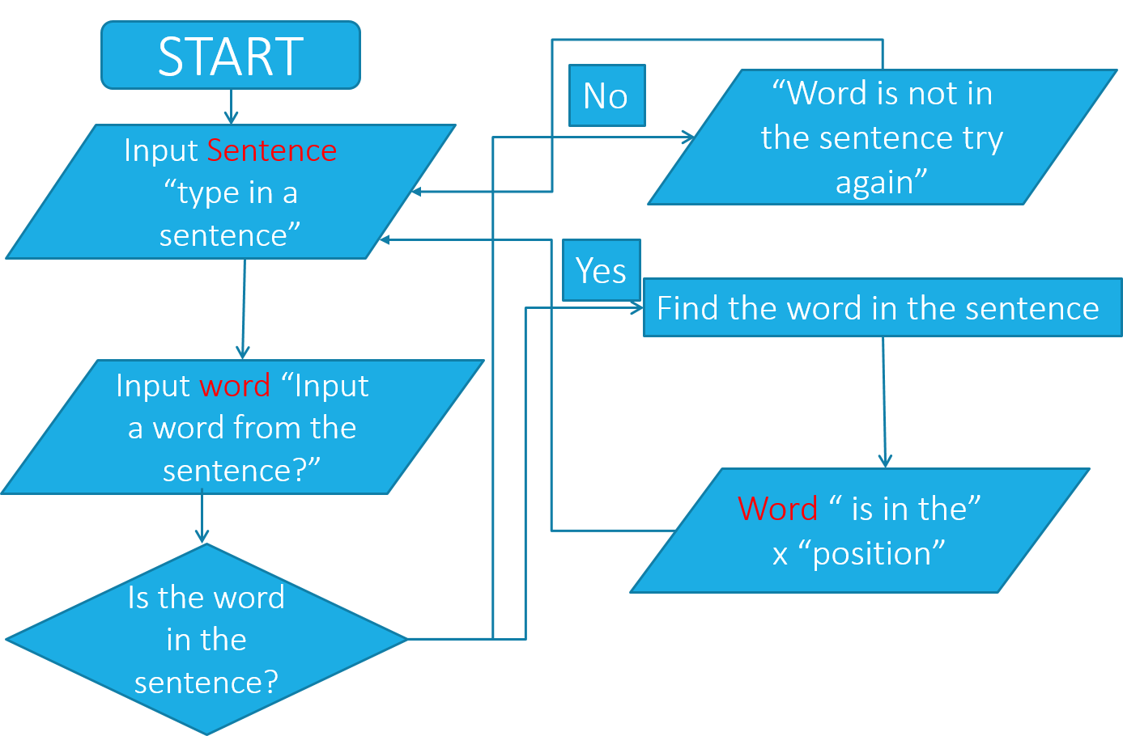
Flow Chart

Slide 8
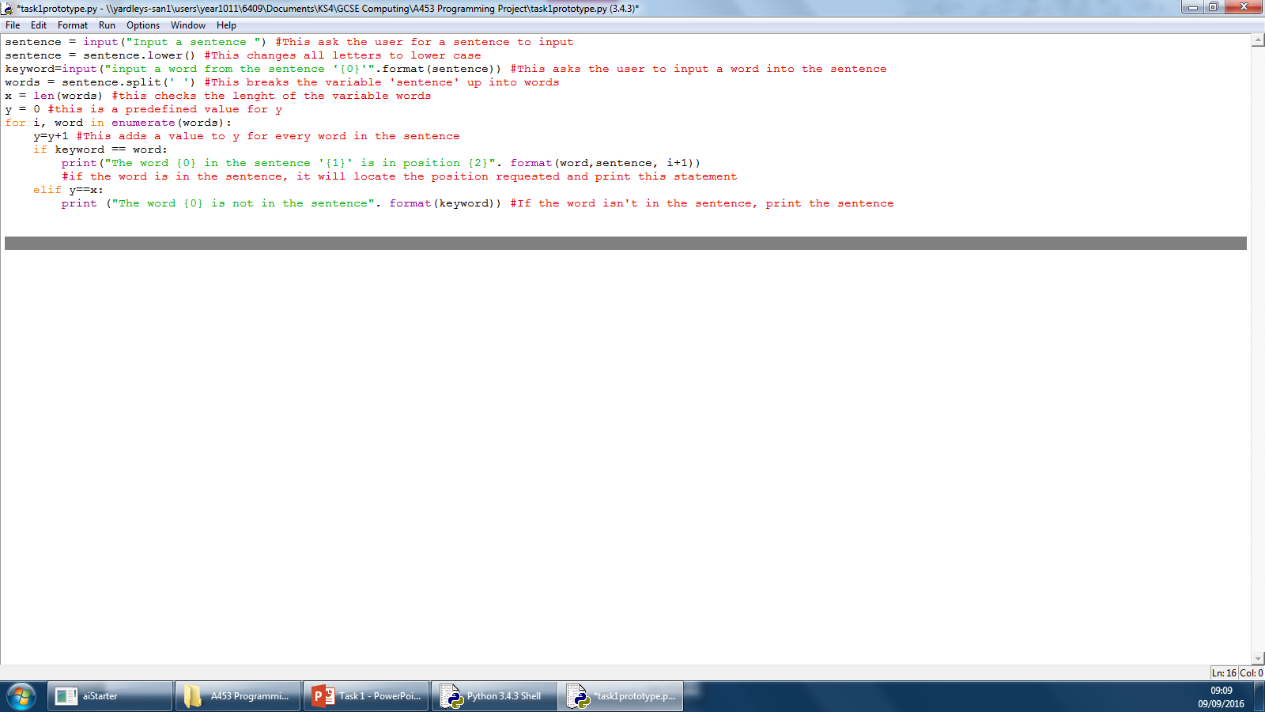
Development (Inputs)
This phrase is outputted to the user asking them to input a sentence
The variable sentence stores whatever the user inputs

Slide 9
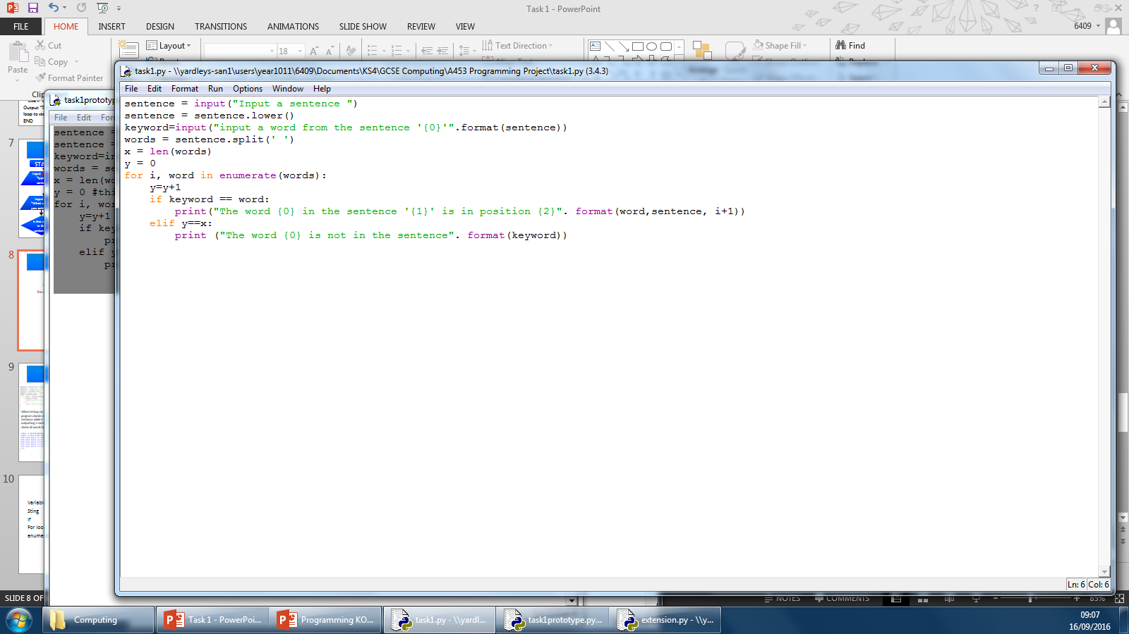
Development (Case Sensitivity)
The create another variable that changes the previous variable sentence
This operator changes all upper case letter to lower case in the variable sentence

Slide 10
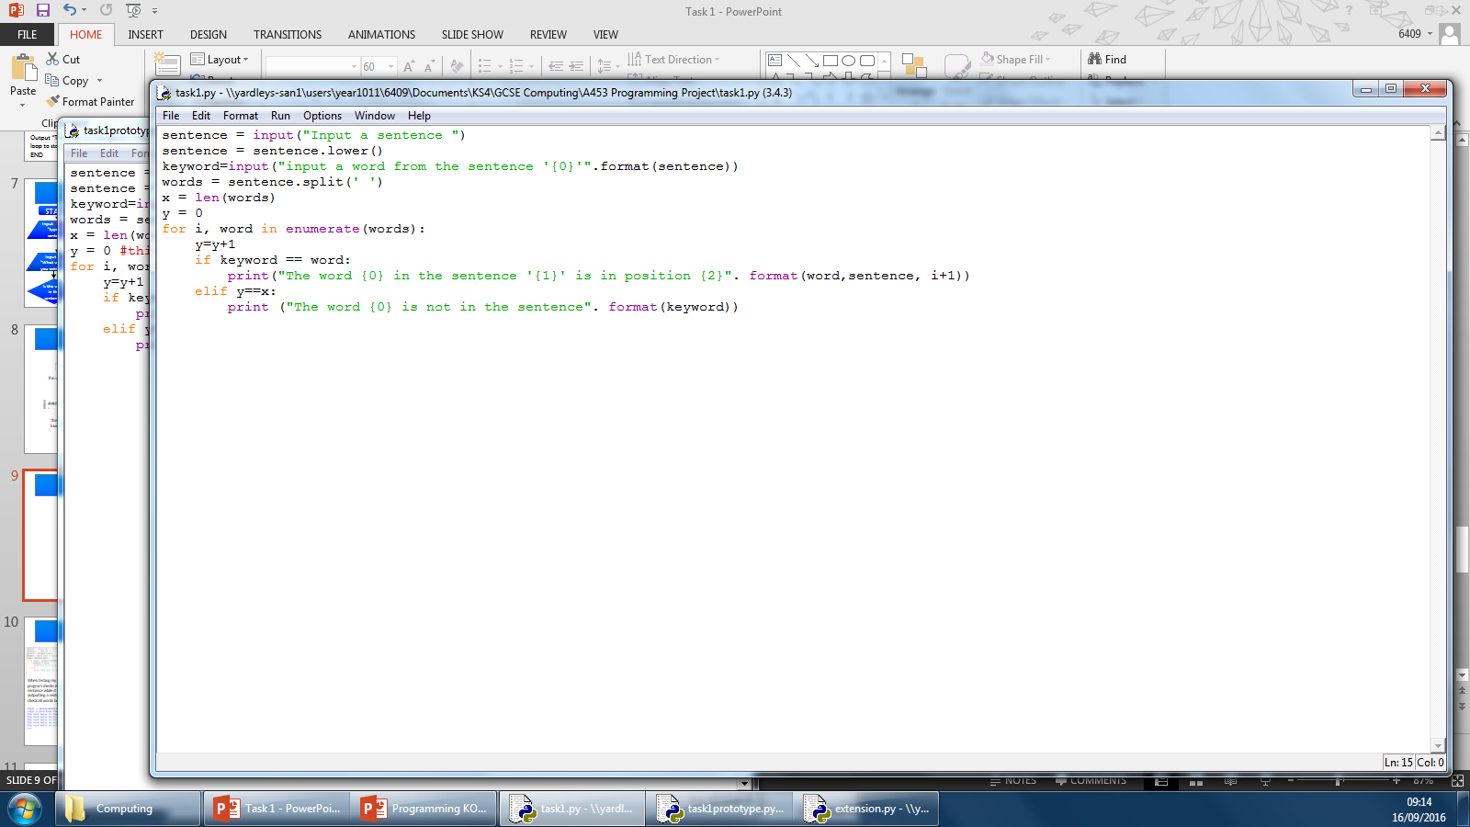
Development (Inputs)
The operator changes “{0}” to what ever is in the brackets, in this case the variable sentence
The creates a variable called keyword that the user inputs which should be from the sentence.

Slide 11
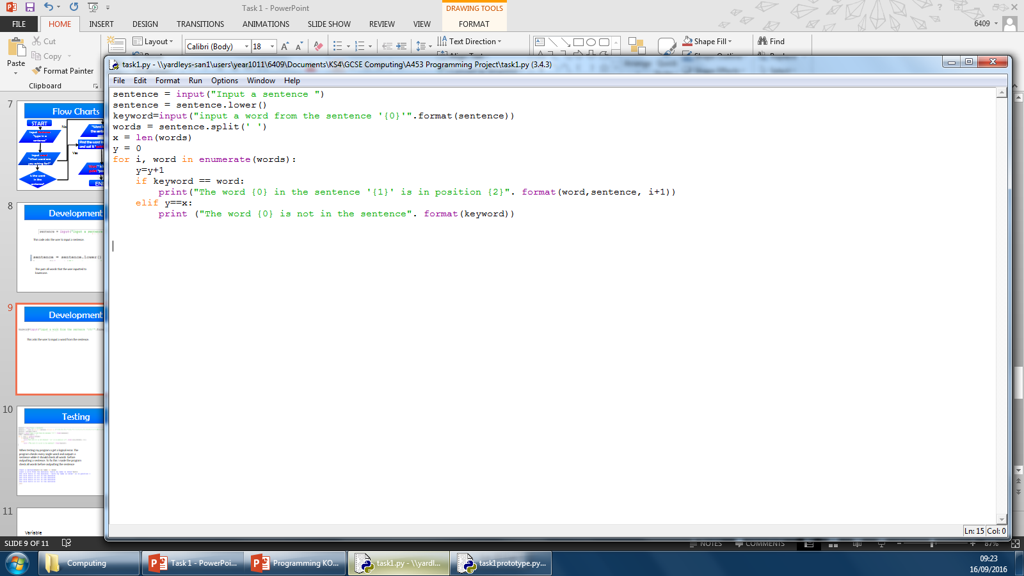
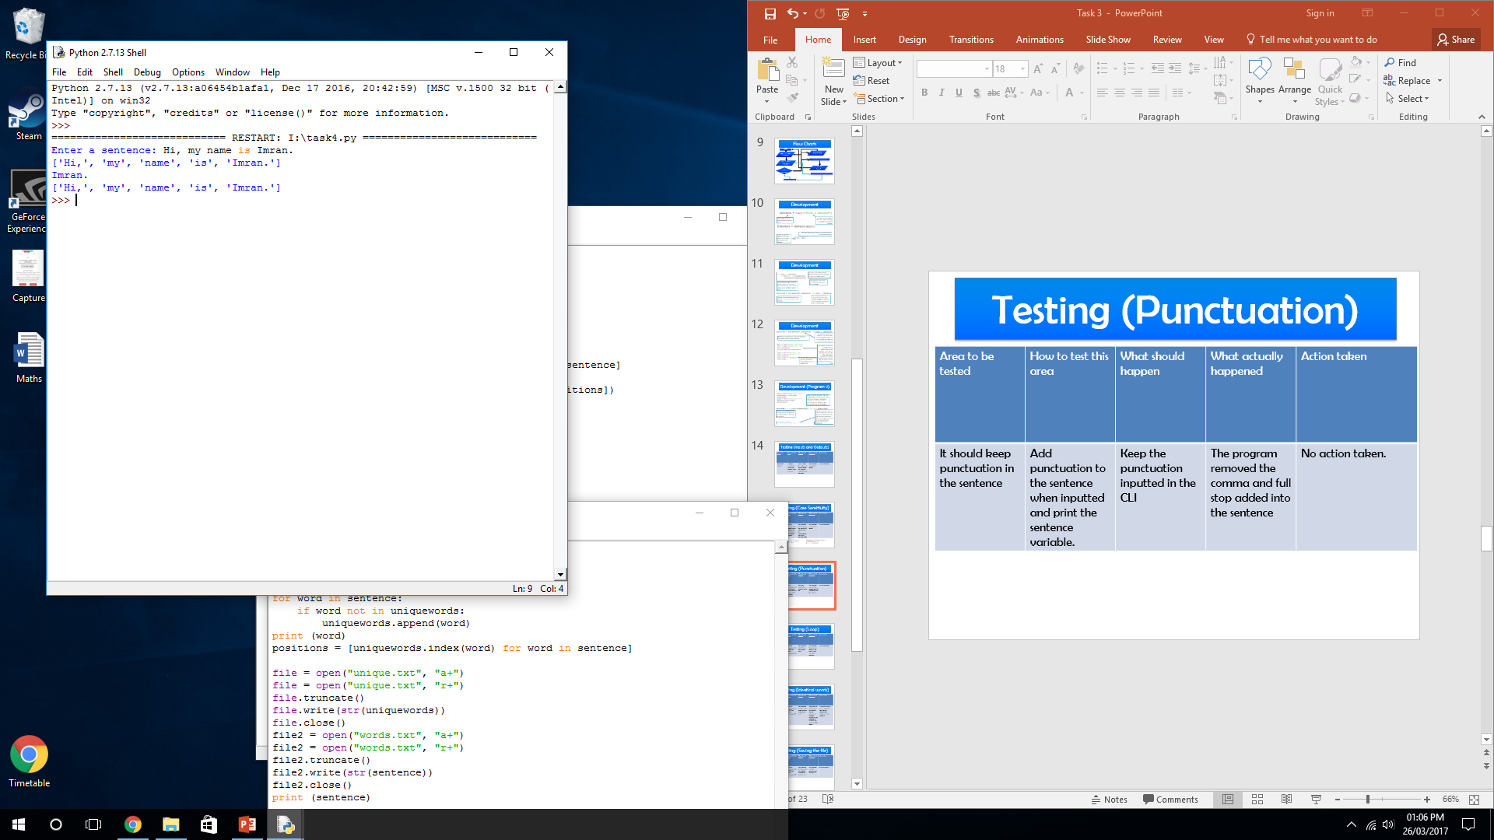
Development (Operators)
This creates a variable which splits all the words inputted into the sentence into individual words
The operator I shown to splits the words when printed out

Slide 12
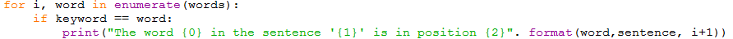
Development (List Creation)
The enumerate puts the words into a list
This is a Boolean data type.
The if statement acts when a statement is true or false, so in this situation, if the word asked is in the sentence it will tell you the position.
If the word the user inputted is in the sentence, it will tell the user where the word is in the sentence

Slide 13

Development (Error Message)
If the word is not in the sentence it will present an error message.
The break function stops the program from looping for a logical error

Slide 14
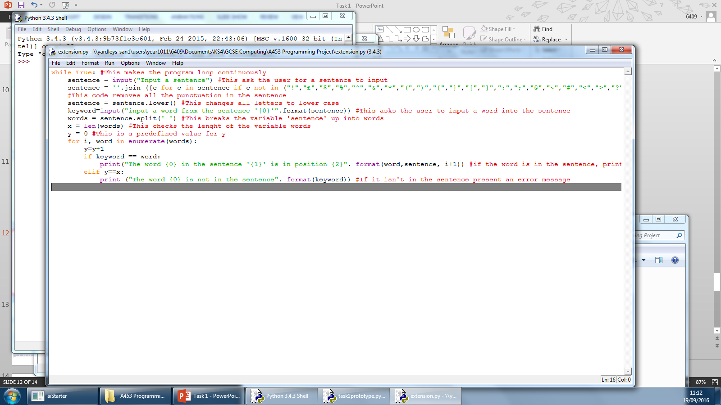
Development (Loop)
Entering this into the text editor loops the program continuously
The ‘while True’ command here means that the program will continue to loop until you kill it, allowing you to test different sentences and scenarios. Although not essential to the program, it makes it easier to use and allows the user to go through the program several times without restarting the program.

Slide 15
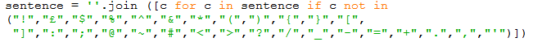
Development (Punctuation)
The enumerate puts the words into a list
The .join function is used to make sure that the words are split and not the letter. If the .join function is removed it splits every single character in the sentence including spaces. (seen in the screenshot)
This removes all punctuation in the sentence, so even if the user adds punctuation to the sentence, the program will remove all punctuation. It removes it by replacing the punctuation with a blank space.

Slide 16
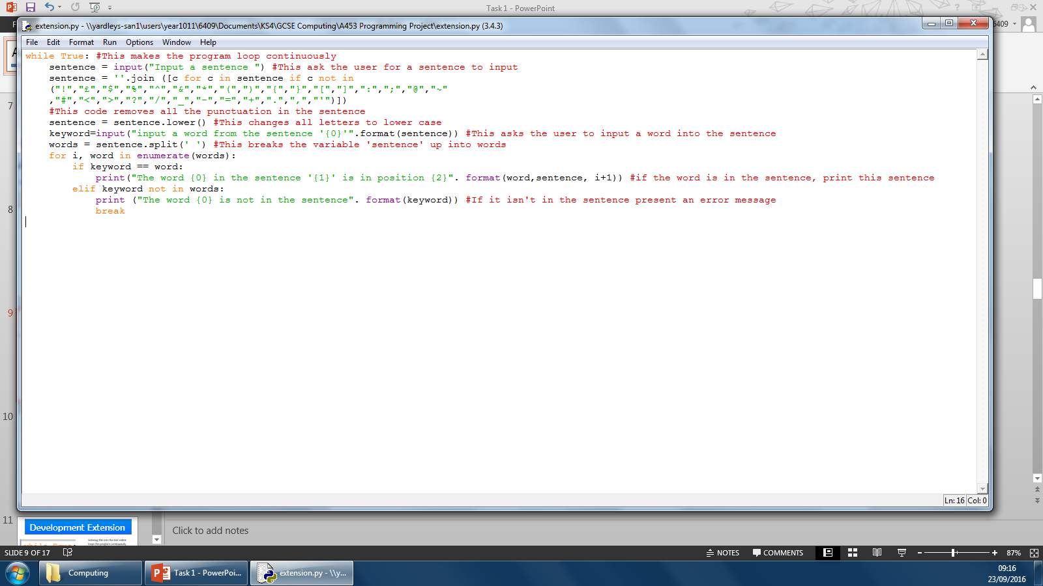
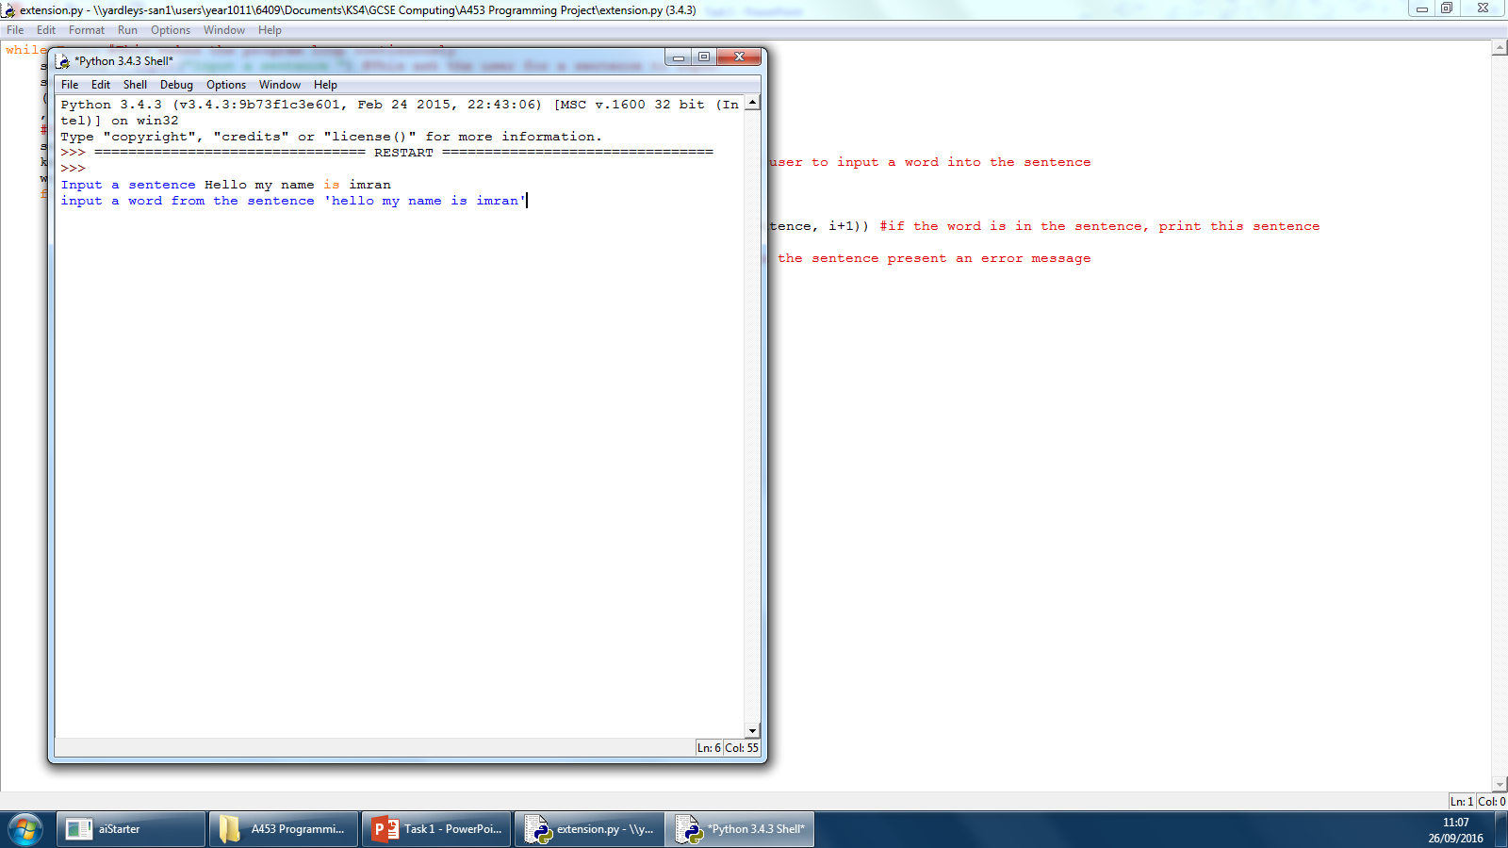
Testing (Inputs)
Area to be tested | How to test this area | What should happen | What actually happened | Action taken
In this test I will be testing if variables can store data from the user inputs correctly | I will run the program in the RTE. A numerous amount of times with different variations | If the program works correctly the inputted sentence will be printed out into the run-time-environment. | The program worked correctly | No action taken

Slide 17
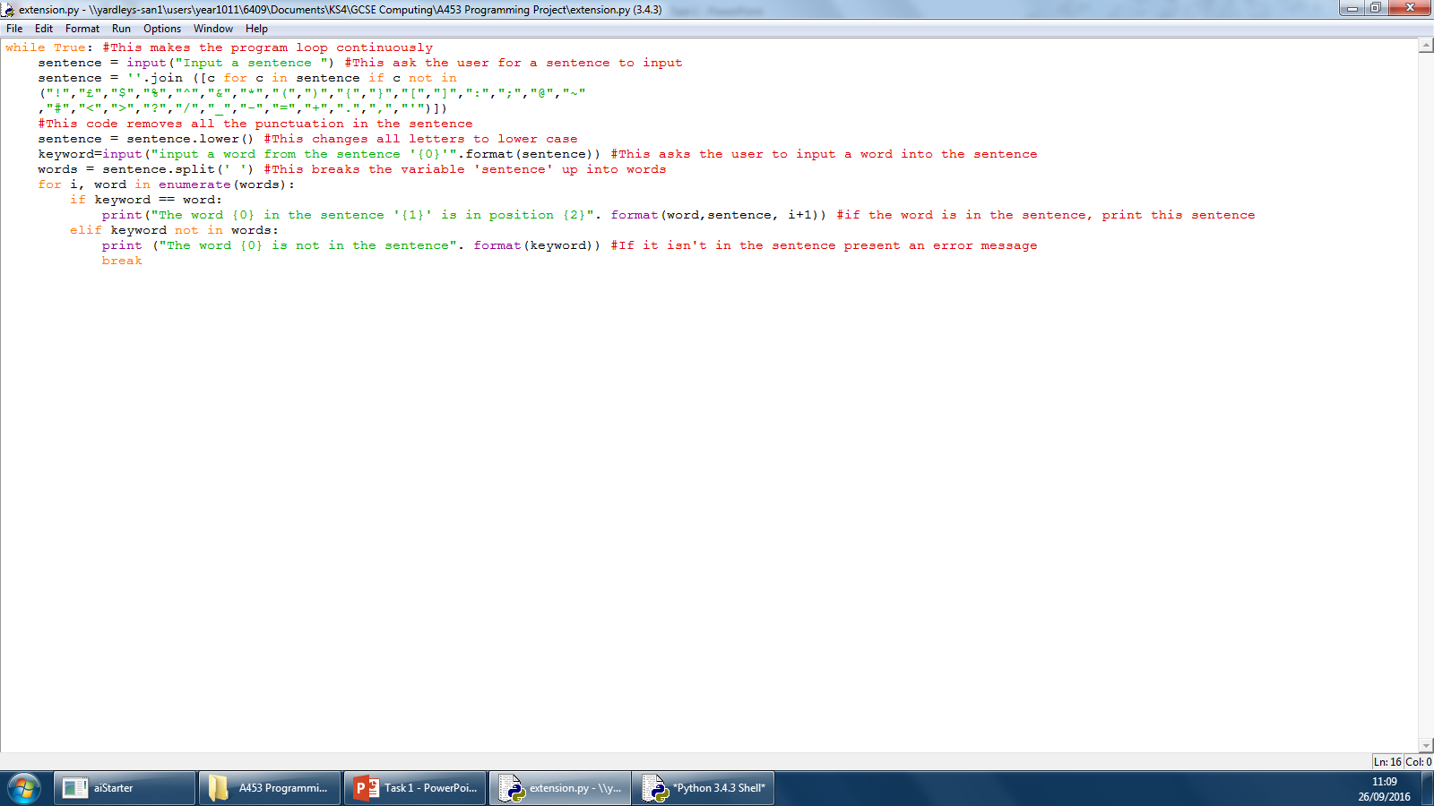
Testing (Case Sensitivity)
Area to be tested | How to test this area | What should happen | What actually happened | Action taken
In this test I will be seeing if the program treats the same word with different capitalisation | I will run the program in the RTE and inputting a sentence with some sort of capitals. | If the program works correctly it will output the sentence in all lower case. | The program returned the input into a lowercase format | No action taken

Slide 18
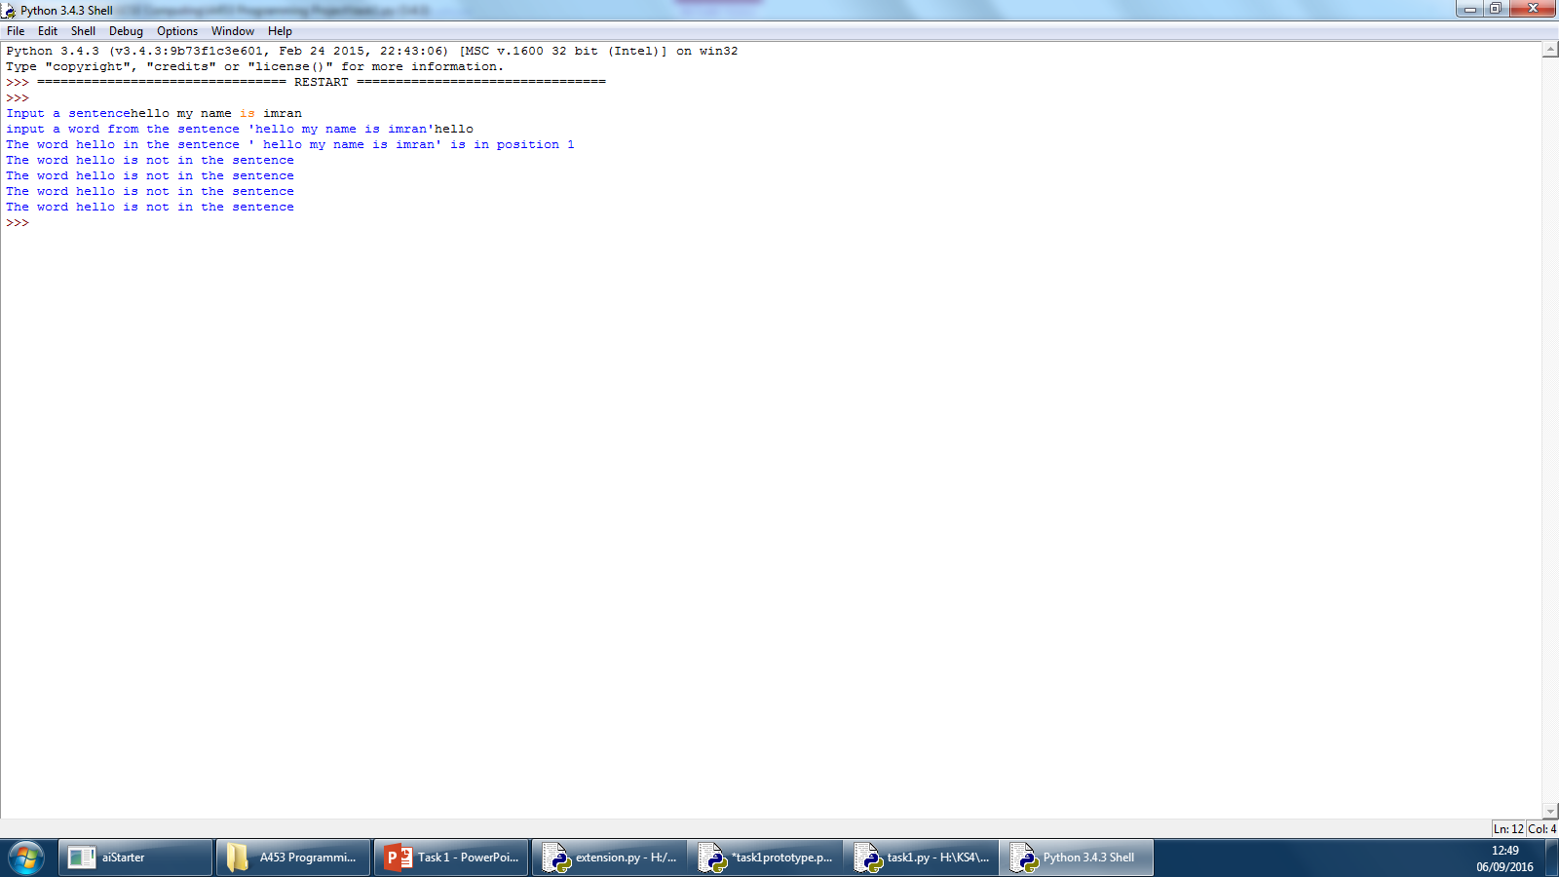
Testing (Positions)
Area to be tested | How to test this area | What should happen | What actually happened | Action taken
In this area, I am testing to see if the program can find the positions of words in the sentence. | I should run the program in the RTE asking for a position of a word in the sentence. | The program should find the word I am asking in the sentence and tell me. | The program asked for every word in the sentence , so if it is not the word asked it will present the error message for each individual word. | I changed the code so instead it uses ‘elif’ instead of the ‘if’ statement. (see slide 22)

Slide 19
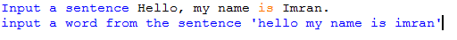
Testing (Punctuation)
Area to be tested | How to test this area | What should happen | What actually happened | Action taken
It should remove conventional punctuation in the sentence | Add punctuation to the sentence when inputted | Removes punctuation in the sentence | The program removed the comma and full stop added into the sentence | No action taken.

Slide 20
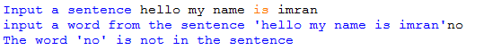
Testing (Error Message)
Area to be tested | How to test this area | What should happen | What actually happened | Action taken
In this test I am testing whether the program presents an error message | Intentionally enter a word not in the sentence | The program should output an error message | The program tells the user that the word is not in the sentence | No action taken.

Slide 21
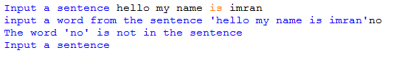
Testing (Loop)
Area to be tested | How to test this area | What should happen | What actually happened | Action taken
I will be testing if the program restarts the program after ending. | I will test this by running the program as usual and see what happens afterwards. | after I get a position for the word inputted in the sentence. It should loop back | The program loops back no matter if the word is in or not in the sentence. | No action taken.

Slide 22
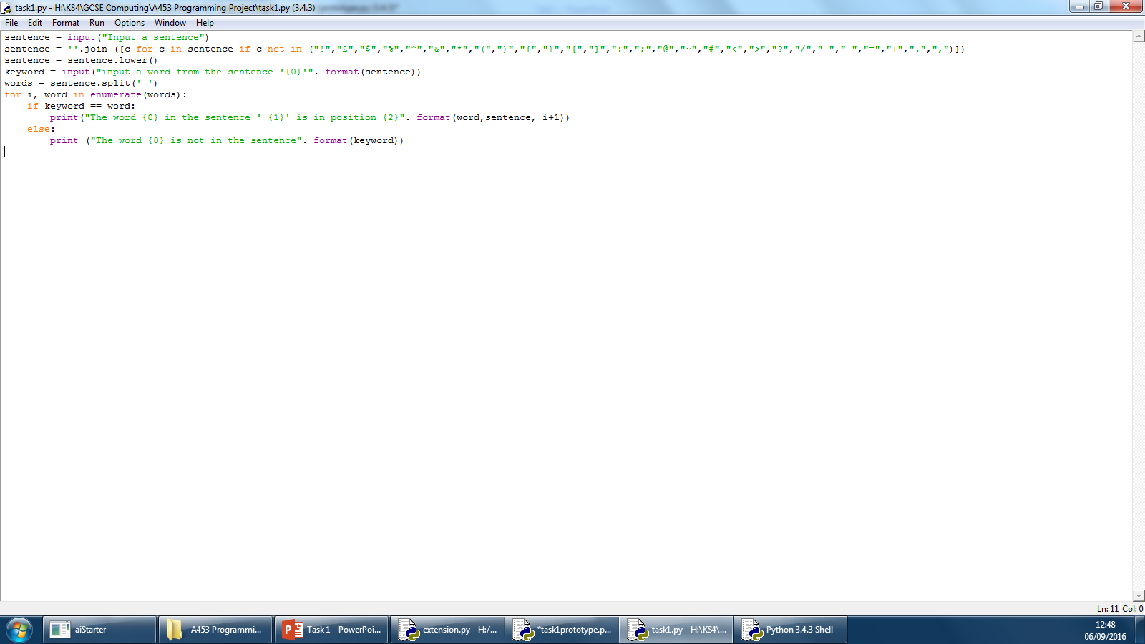
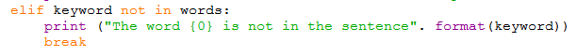
Testing
Before
After
When testing my program in the run time environment, I get a logical error. It doesn’t check all words before outputting a sentence. To fix this I made the program check all words before outputting anything by changing “else” into an “elif” statement and making the program ask if it is not in the sentence.
I also needed to use the break function to stop the loop from occurring
Logical Error

Slide 23
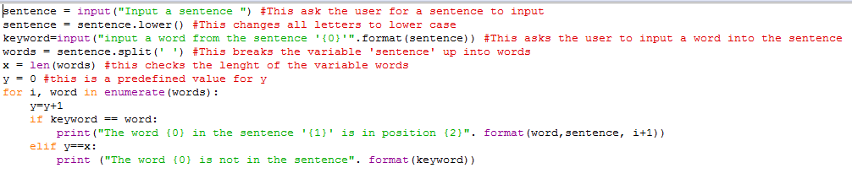
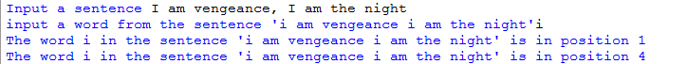
Final Code

Slide 24
Evaluations
In this controlled assessment my first task was to develop a program that analyses a sentence and finds the position of a word in the sentence when asked.
In my success criteria I stated that the program works with no errors, even though I came across a few errors (refer to slide 19) my program eventually worked as it should with no syntax or logical errors. This was most challenging as logical errors do not tell you what is wrong with the code.
I said that the program should allows the user to input values and store them in variables, which can be received back to the user, the inputs and outputs in my program works correctly. The inputs and outputs were already straight forward as I already know how they work. This can be improved by letting the user choose whether they want to input a sentence or use a pre-set one.
The program shouldn’t be case sensitive to stop any errors, this is successful as the program puts whatever the user inputs into a lower case format. This was fairly simple as it is just one line of code that turns all the letters of that variable sentence to lower case.
My program also needs to make sure that there is no punctuation in the sentence that the user enter, to do this I created a line of code that removes punctuation. This was partially successful as I can only remove conventional punctuations due to an error, if I had more time I would make sure the program can remove all punctuation from the sentence.
My program also should present an error message when the word is not in the sentence, I have exceeded the success criteria by making the program loop after the program ends. This was challenging as my program had an error where the program ended when the word is not in the sentence but I managed to fix it with no errors.
Overall, I did all the tasks and met all the criteria successfully, meaning that I have completed the tasks. After testing and correcting my program, the program works correctly with no faults or errors. If I had more time I would let the program block any characters not allowed, instead of having an error message.

Slide 25
Glossary
Variable - Something that stores information or data which can be modified
Operators - Used to change variables in the program
Inputs – What the user enters into the program
Outputs – What the computer presents from processing the inputs
Assignments – Another form of an operator which change variables
Sequence – A array stored in a variable in the program
Conditional – An if statement basing the out come from what is given
Iteration– Allow you to update variables in the program
Loops – When the program starts again after ending
Count Loops – When the program loops a certain amount of times
Boolean – Used in an if statement, these are operators basing things on actions e.g. and, or, not
String – Something that contains numbers like a variable
Arrays – A list in a variable
Logical Error – An error in which the program does not work as it was design but does not crash
Syntax Error – An error when there is faults in the code not letting the program run

